Slide 1
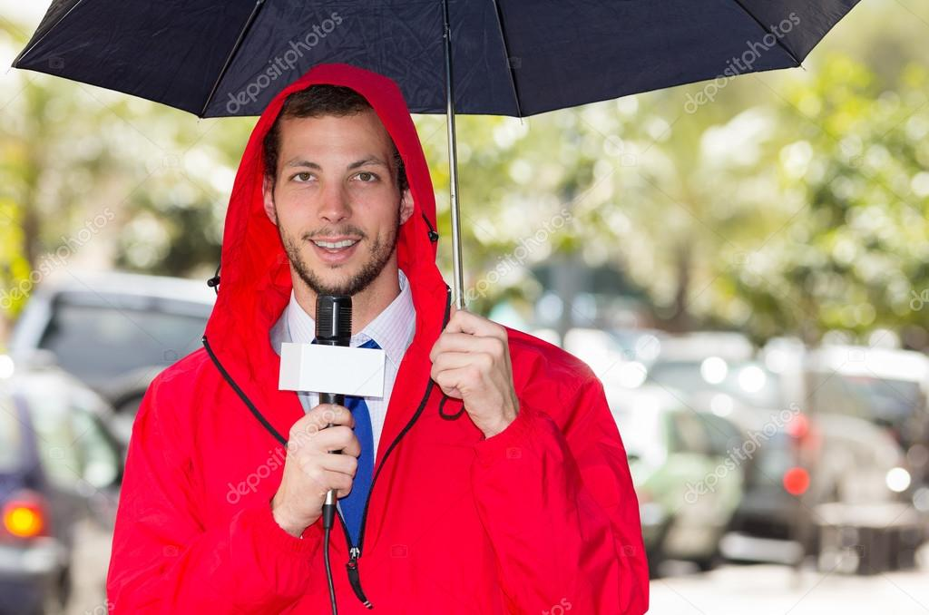
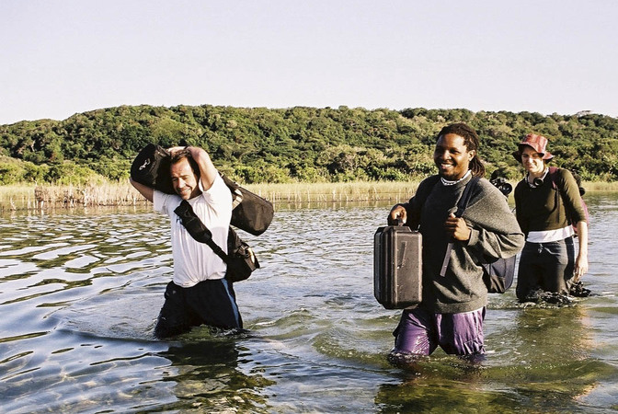
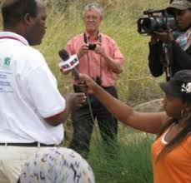
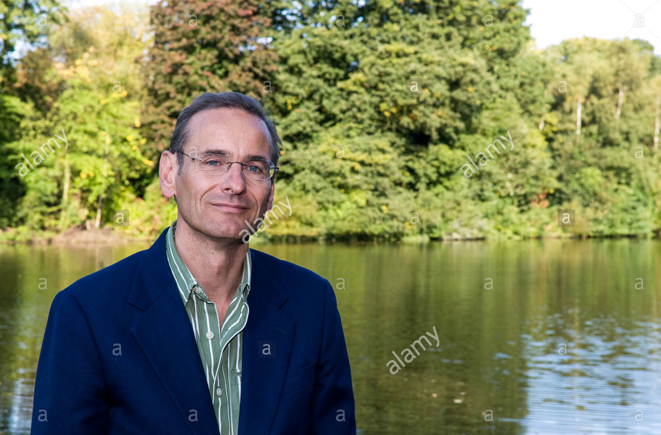
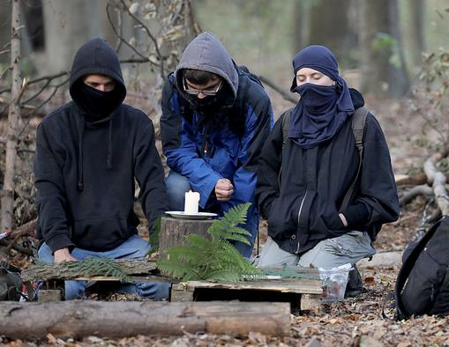
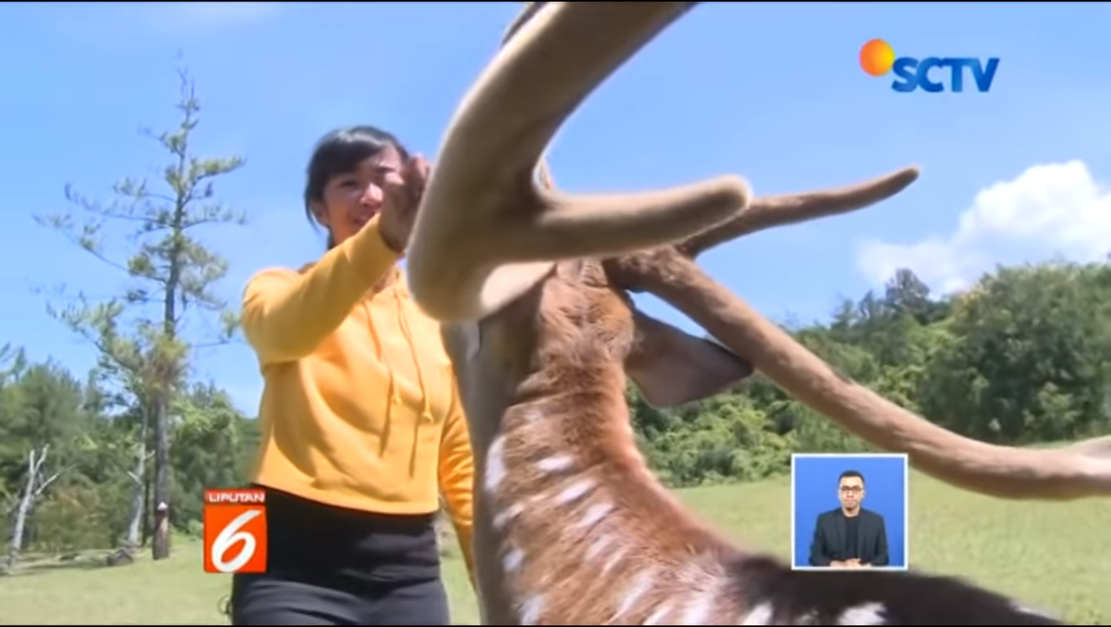
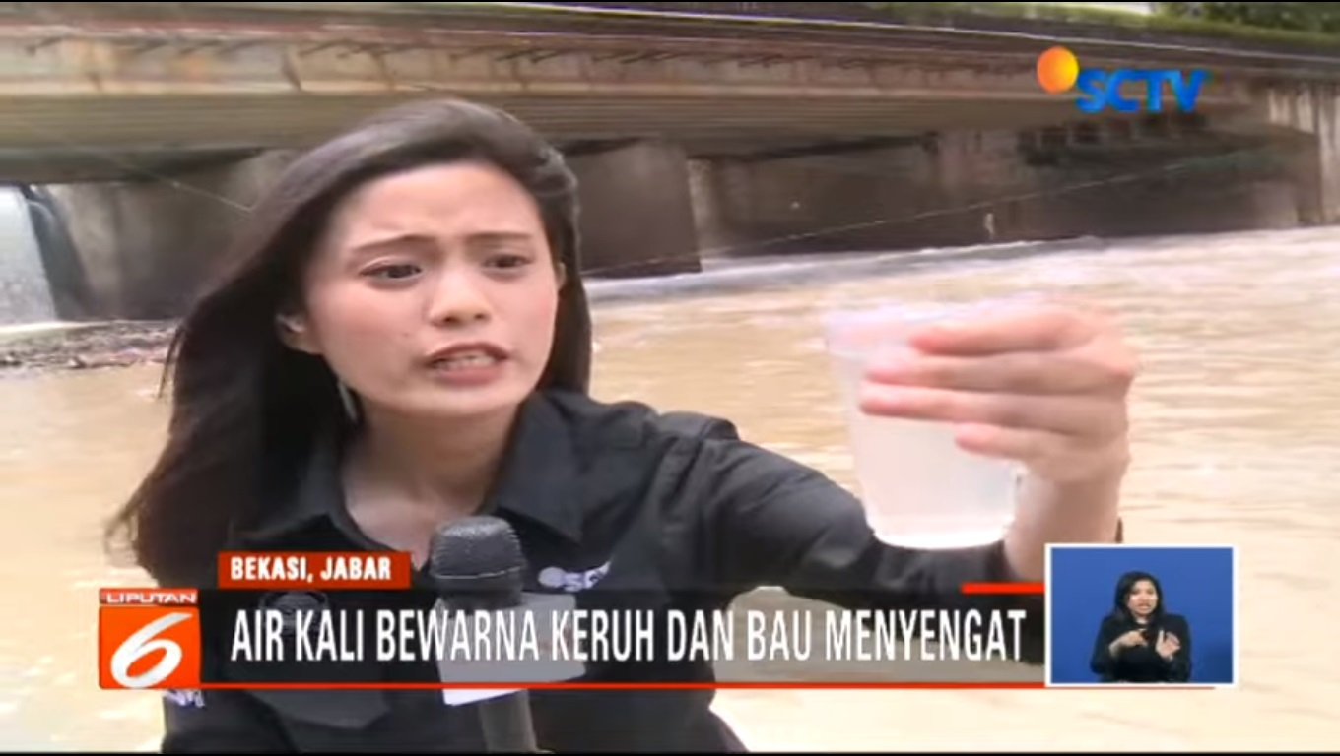
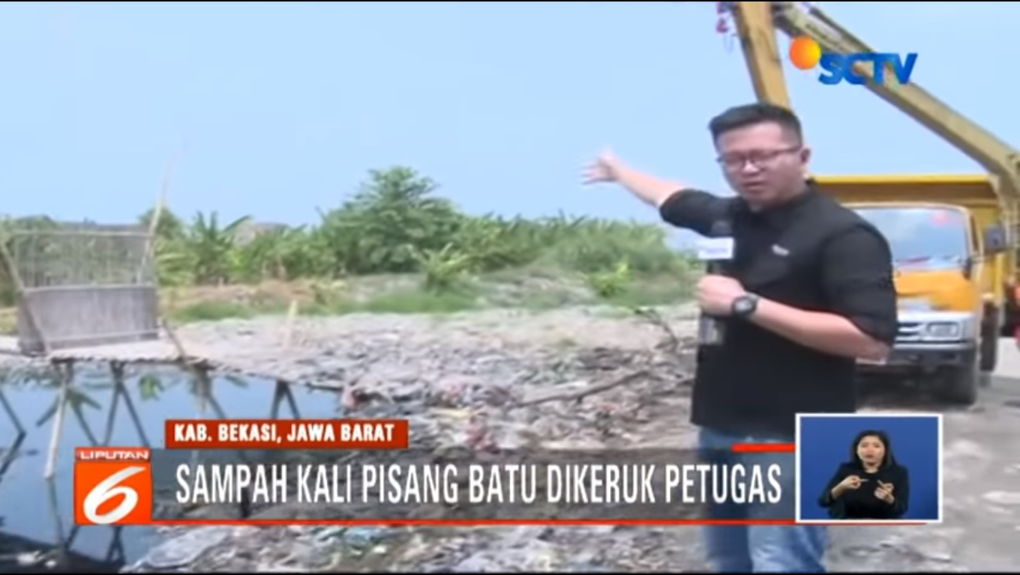
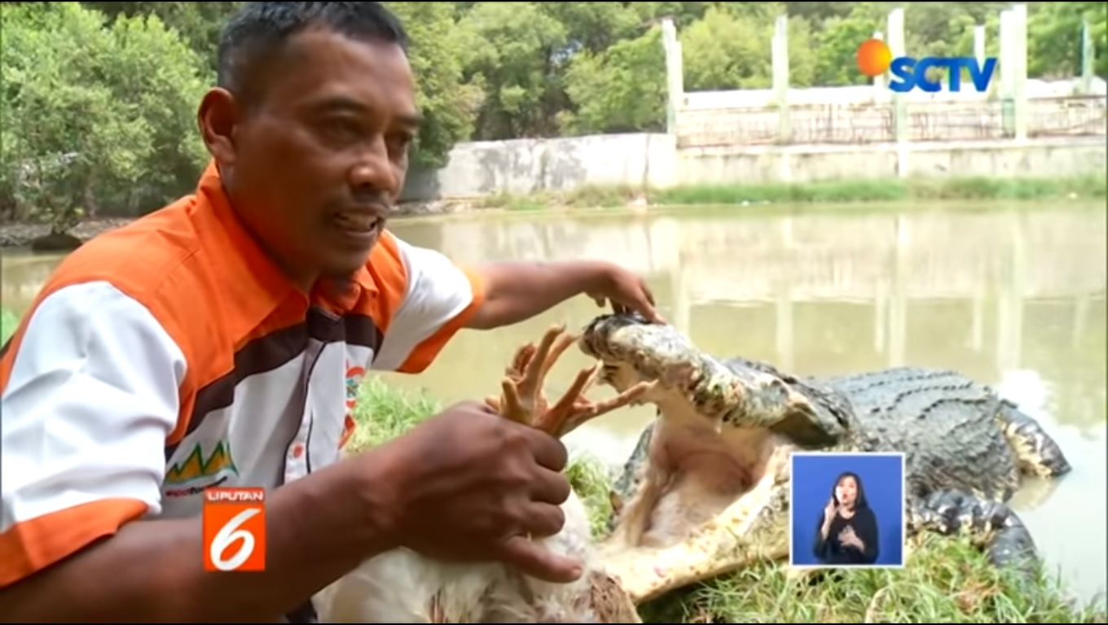
Sikap & Kecakapan yang harus
dimiliki oleh Jurnalis Lingkungan
Program Studi Ilmu Komunikasi
Fakultas Humaniora dan Bisnis
Oleh: Maya Rachmawaty, MSc
Kamis, 21 February 2019

Slide 2
have you read the book?
Chapter 3:
“Gambaran Wartawan Lingkungan Hidup”
pp. 103 - 129

Slide 3
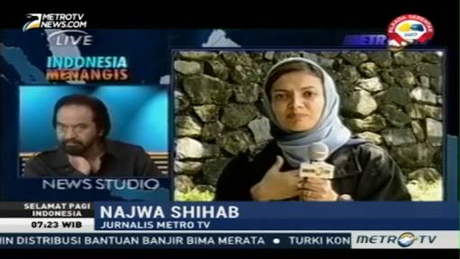
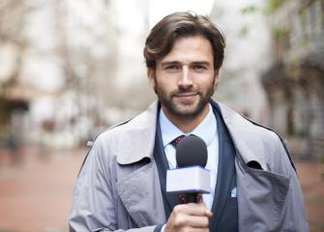
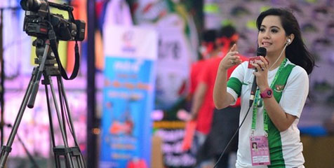
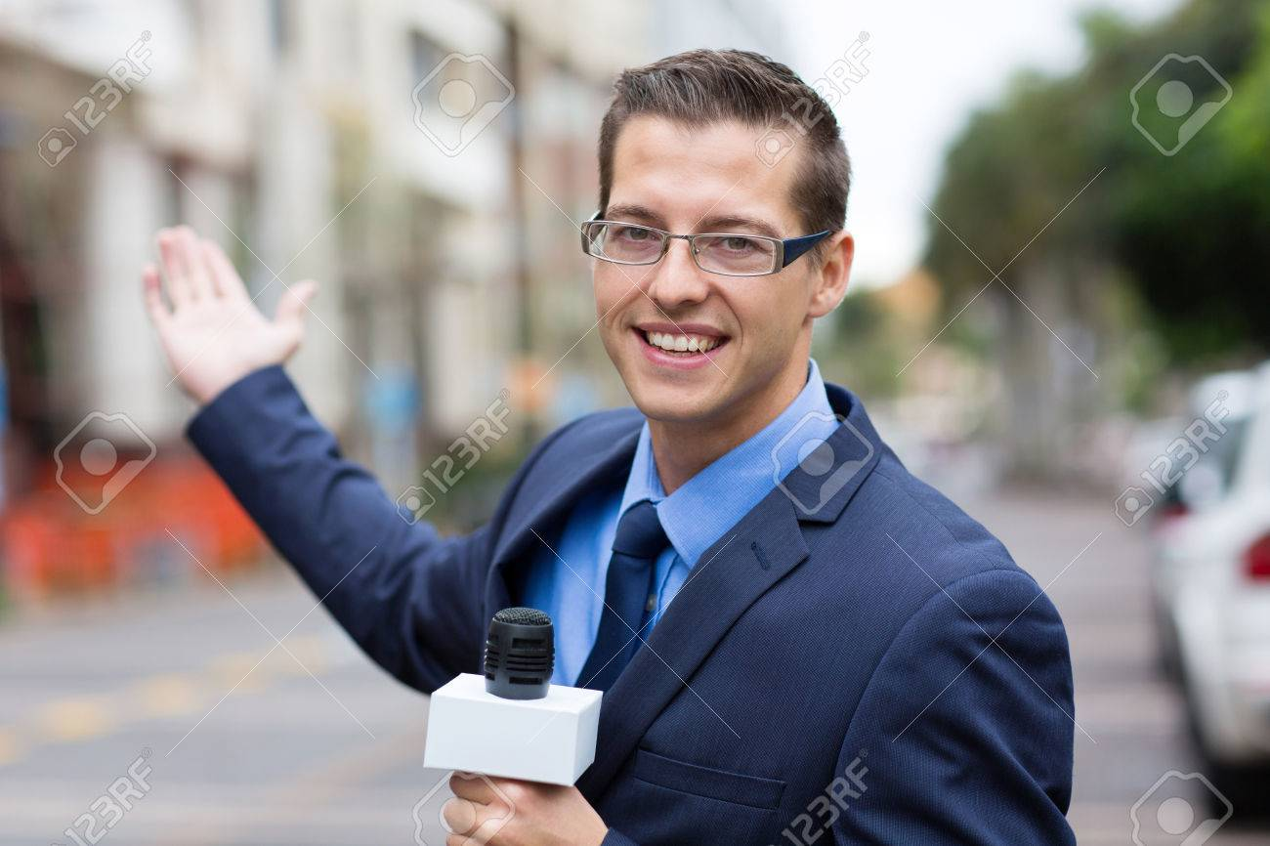
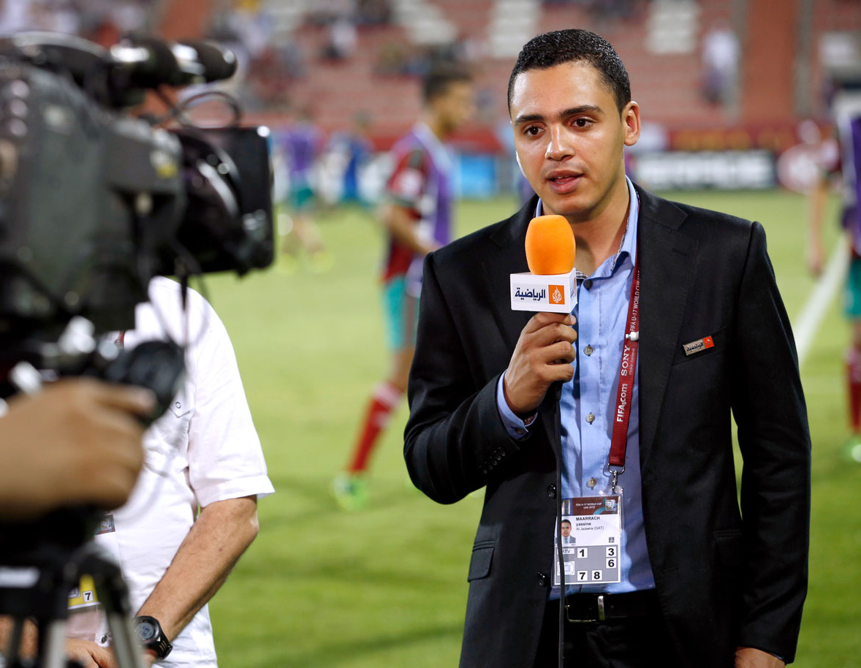
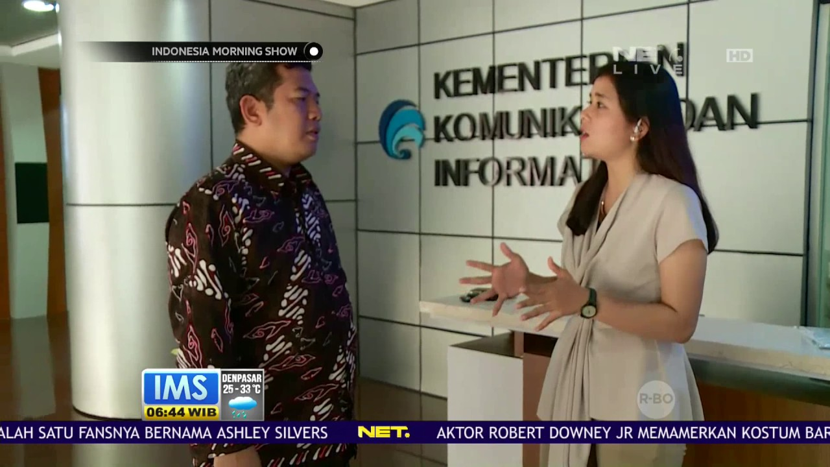
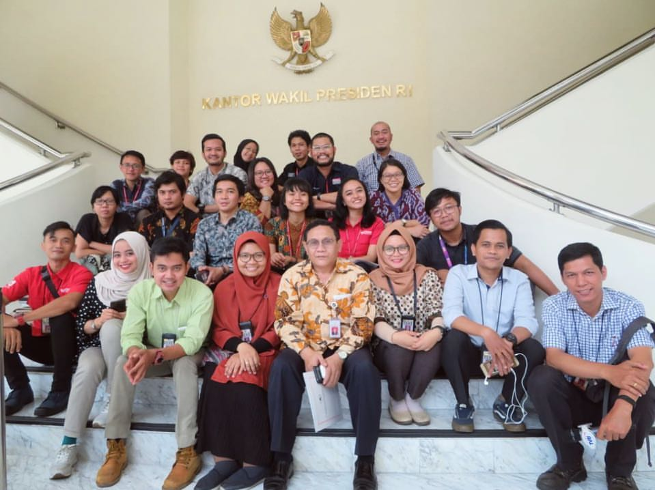
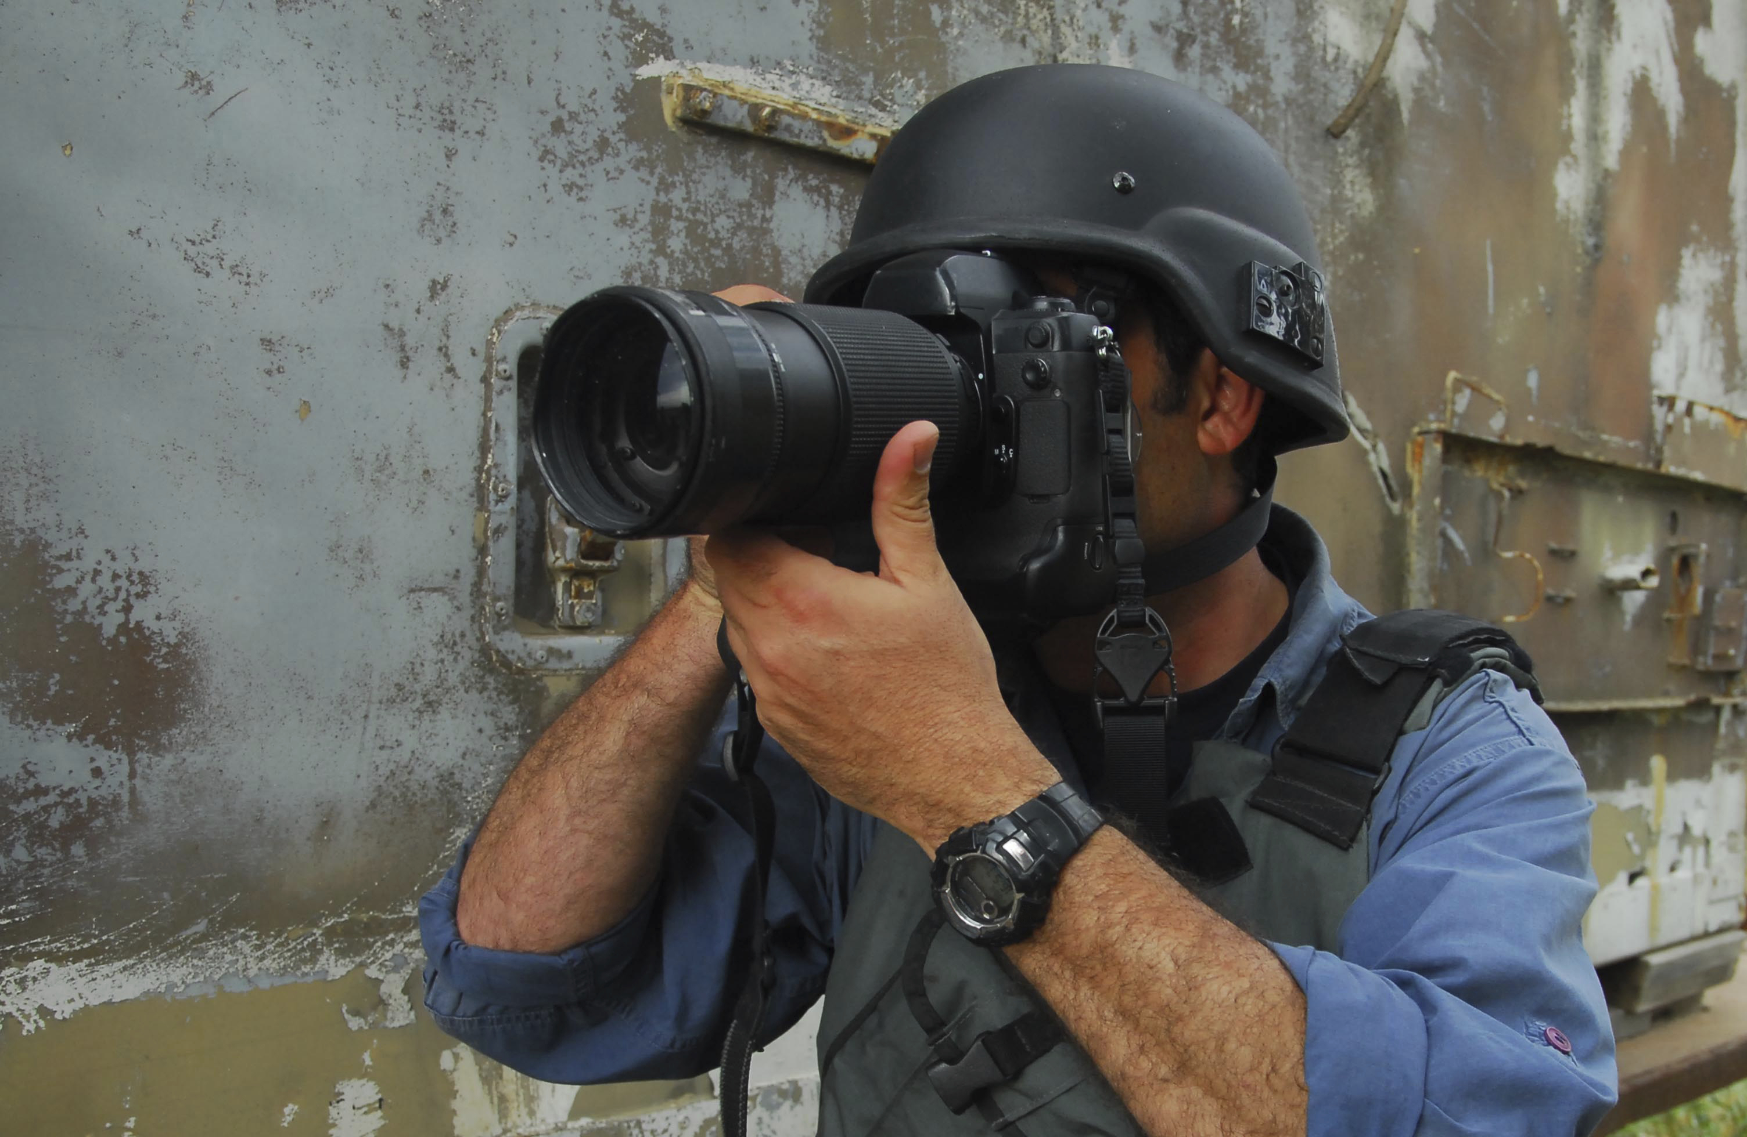
Jurnalis / Wartawan / Reporter
Abroad
Indonesia
Politics
Politik Hukum & HAM (Polhukam)
Economics
Social
Sosial & Masyarakat (Sosmas)
Criminal
Sport
Ekonomi
War
Kriminal
Environment
Olahraga

Slide 4
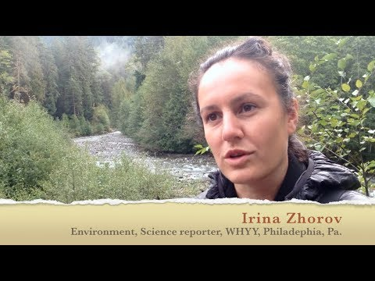
Environmental reporters are journalists who specialize in gathering and presenting environmental information that is newsworthy and timely. Like all journalists, they write, film, and transcribe news reports, commentaries, and features for a variety of media, including print, television, radio, and the Internet (Eco Canada, 2019).
Jurnalis Lingkungan
Reporter lingkungan adalah jurnalis yang berspesialisasi dalam mengumpulkan dan menyajikan informasi lingkungan yang layak diberitakan dan tepat waktu. Seperti semua jurnalis, mereka menulis, memfilmkan, dan menyalin laporan berita, komentar, dan fitur untuk berbagai media, termasuk media cetak, televisi, radio, dan Internet (Eco Canada, 2019).

Slide 5
1. Reporter 2. Redaktur Umum / Redaktur Bidang / Editor 3. Redaktur Pelaksana 4. Pimpinan Redaksi (Pemred)
Who Are They?
Televisi / Radio
1. Reporter
2. Associate Producer / Producer / Senior Producer
3. Producer Executive
4. Manager
5. General Manager
6. Pimpinan Redaksi (Pemred)
Newspaper / Portal Berita

Slide 6
Jurnalis Lingkungan
Wartawan Kebijakan
Kebijakan pengolahan sampah plastik
Wartawan Keilmuan
Kasus Lapangan Golf di Thailand, Indonesia dan Jepang
Wartawan Pembangunan
Impor Plastik dan Pembangunan Instalasi Listrik & Nuklir
https://www.youtube.com/watch?v=DpWd6462-LA

Slide 7
What They Actually Do
Merencanakan Peliputan
Mengumpulkan Fakta (Observasi, Wawancara & Membaca)
Menyusun Berita
Mengedit Berita
Menyajikan Berita

Slide 8
What They Actually Do
Intrepretative Reporting (Benjamin S. Bloom dalam Lambeth, 1992):
Pengetahuan
Pemahaman
Aplikasi
Analisis
Sintesis
Evaluasi

Slide 9
Sikap / Attitude

Cinta / Peduli Lingkungan
Kritis Terhadap Isu Lingkungan


Aktif

Berani / Suka Tantangan

Berimbang / Pro Keberlangsungan Lingkungan Hidup

Profesional
https://www.youtube.com/watch?v=crRWjMICe1I

Slide 10
Kecakapan / Skills

Memahami Isu Lingkungan

Observasi

Menggali Informasi / Wawancara

Menulis Berita

Public Speaking

Mengambil Foto / Video

Slide 11
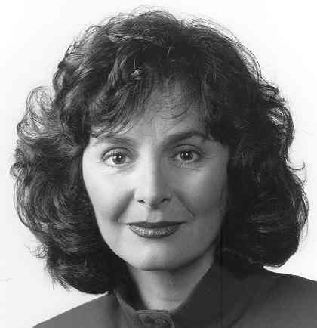
If you do not keep up with current events in this line of work, you are not doing your job. I read four newspapers per day, many magazines, news releases, and emails. Watching television and listening to the radio is part of my work. When I have the chance I attend the Canadian Science Writer’s Association conference. It can be very challenging to keep up because you not only have to be familiar with what is happening, you need to be anticipating what is about to happen. A reporter has to always be ready for the next assignment.
There is a growing need for accurate reporting in this area. Awareness of environmental issues stimulates more interest in the environment. I believe the various environmental crises we are facing will become more and more evident and people will start to demand action from their politicians. For myself, I would love to see a new show on the C.B.C. where environmental issues could be discussed on a weekly basis. If the news value of these issues continues to increase we may see such a program.
Eve Savory

Slide 12
TUGAS PROPOSAL LIPUTAN:
1. PENGAJUAN SATU IDE LIPUTAN BERTEMA LINGKUNGAN
2. DISAJIKAN DALAM BENTUK SLIDES / POWER POINT
(MAX. 10 SLIDES)
3. MENCANGKUP:
JUDUL, LATAR BELAKANG, TUJUAN,
LOKASI, TANGGAL DAN WAKTU PELAKSANAAN,
PERALATAN TIM DAN BIAYA YANG DIBUTUHKAN,
SINOPSIS/DESKRIPSI (NARASUMBER, FOCUS/OBEJCT YANG DILIPUT)
4. DIKIRIMKAN MELALUI EMAIL
DEADLINE: KAMIS, 14 MARET 2019, PUKUL 23.59 WIB

Slide 13
.. THANK YOU ..

