Slide 1
Ilmu Komunikasi
Identitas Budaya Bag. 1
Cultural Identity Part 1
Komunikasi Antar Budaya
Pertemuan 5

Slide 2
Who are you?
Write down ten words that you think
describe you

Slide 3
The Importance of Identity
1
Identity development plays a critical role in the individual’s psychological well-being.
2
An understanding of identity is also an essential aspect of the study of intercultural communication
3
The unsettled world that we all live in is in part influenced by adherence to varying perceptions of identity
4
Identity influences and guides expectations about your own and others’ social roles, and provides guidelines for your communication interaction with others.
Samovar et all. 2010. Communication Between Cultures Halaman 182-184 Versi Bahasa Indonesia

Slide 4
Explaining Identity
The abstract, complex, and dynamic concept
“A person’s self-definition as a separate and distinct individual, including behaviors, beliefs, and attitudes” – Gardiner and Kosmitzki.
“Reflective self-conception or self-image that we each derive from our family, gender, cultural, ethnic, and individual socialization process. Identity basically refers to our reflective views of ourselves and other perceptions of our self-images.” – Ting-Toomey.
Cultural identity (Fong):
The identification of communications of shared system of symbolic verbal and nonverbal behavior that are meaningful to group members who have a sense of belonging and who share traditions, heritage, language, and similar norms of appropriate behavior. Cultural identity is a social construction.
Samovar et all. 2010. Communication Between Cultures Halaman 184-186 Versi Bahasa Indonesia

Slide 5
Selected Social Identities
Remember! We have more than one identity.
01
Racial Identity
02
Ethnic Identity
Mongoloid
Caucasoid
Negroid
Capoid
Australoid
Derived from a sense of shared heritage, history, traditions, values, similar behaviors, area of origin, and in some instances, language.
03
Gender Identity
04
National Identity
The meanings and interpretations we hold concerning our self-images and expected other-images of ‘femaleness’ and ‘maleness’. (Ting-Toomey)
Refers to your nationality
Samovar et all. 2010. Communication Between Cultures Halaman 186-191 Versi Bahasa Indonesia

Slide 6
Selected Social Identities
Remember! We have more than one identity.
05
Regional Identity
06
Organizational Identity
Every country can be divided into a number of different geographical regions, and often these regions reflect varying cultural traits.
In some cultures, a person’s organizational affiliation can be an important source of identity.
07
Personal Identity
08
Cyber and Fantasy Identity
Consist of those characteristics that set one apart from others in his or her in-group, those things that make one unique, and how one sees oneself.
The internet provides an opportunity to escape the constraints of everyday identities. (Suler)
Samovar et all. 2010. Communication Between Cultures Halaman 191-194 Versi Bahasa Indonesia

Slide 7
Any questions?

Slide 8
Acquiring and Developing Identities
Three-stage Model from Phinney
Final stage
Second stage
Ethnic Achievement
First stage
Ethnic identity search
Unexamined ethnic identity
Samovar et all. 2010. Communication Between Cultures Halaman 195 Versi Bahasa Indonesia

Slide 9
Acquiring and Developing Identities
Four-stage Model from Martin and Nakayama
Final stage
Third stage
Integration
Second stage
Resistance and separatism
First stage
Conformity
Unexamined identity
Based on how they were achieved, your identities can also be classified as ascribed or avowed. This refers to whether your identities were obtained involuntarily or voluntarily.
Samovar et all. 2010. Communication Between Cultures Halaman 196 Versi Bahasa Indonesia

Slide 10
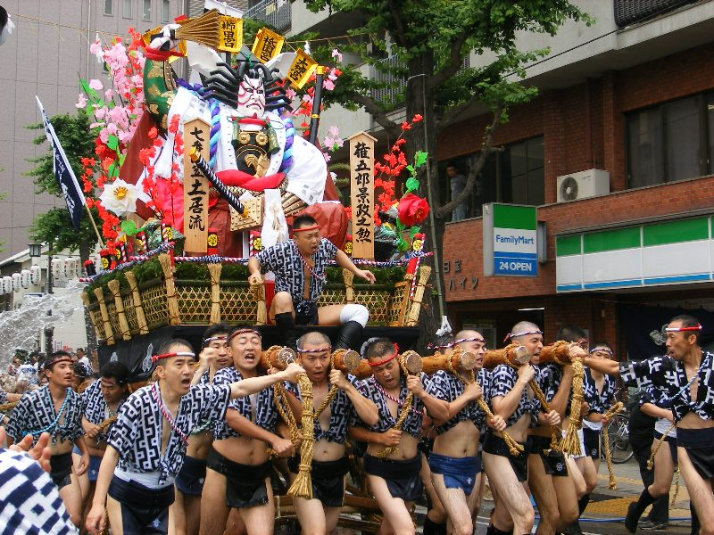
Establishing and Enacting Cultural Identity
The communication employed to create and enact identity can take a variety of forms, including conversation, commemorations of history, music, dance, ritual, ceremonial, and social drama of all sorts.
Identity can be displayed in cultural rites of passage.
Samovar et all. 2010. Communication Between Cultures Halaman 196-199 Versi Bahasa Indonesia

Slide 11
Identity in Intercultural Interactions
Your culture has shaped your understanding and expectations as to what are the correct communication practices for various social setting.
However, this understanding are cultural bound, and what is appropriate in one culture may be inappropriate in another.
In order to communicate effectively in an intercultural situation, an individual’s avowed cultural identity and
communication style should match the identity and style ascribed to him or her by the other party.
Samovar et all. 2010. Communication Between Cultures Halaman 199-200 Versi Bahasa Indonesia

Slide 12
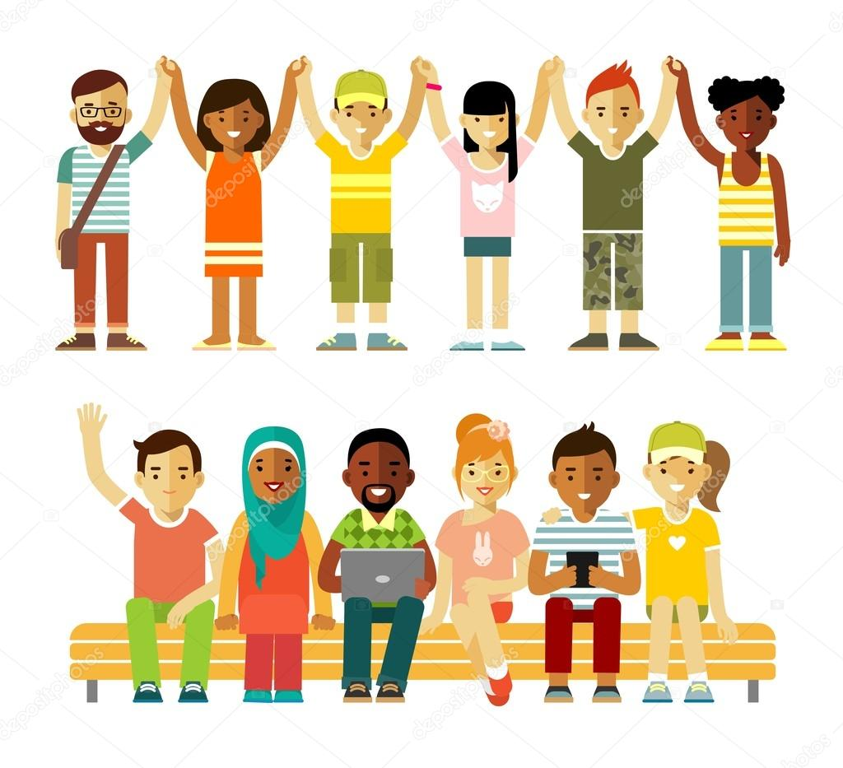
Identity in Multicultural Society
“Cultural Identity becomes blurry in the midst of cultural integration, bicultural interactions, interracial marriages, and the mutual adaptation processes.” – Chuang.
Intercultural transients (Omwumechilli et al):
Travelers who regularly alternate residence between their homeland and a host foreign country and must manage frequent cultural changes and identity negotiations.
Issues of identity can be expected to remain complex – and perhaps become more so – as multiculturalism increasingly characterizes contemporary society.
Samovar et all. 2010. Communication Between Cultures Halaman 200-202 Versi Bahasa Indonesia

