Slide 3
Chapter 13
Statement of Cash Flows
Financial Accounting, IFRS Edition
Weygandt Kimmel Kieso

Slide 4
Study Objectives
Indicate the usefulness of the statement of cash flows.
Distinguish among operating, investing, and financing activities.
Prepare a statement of cash flows using the indirect method.
Analyze the statement of cash flows.

Slide 5
Statement of Cash Flows
The Statement of Cash Flows: Usefulness and Format
Preparing the Statement of Cash Flows—Indirect Method
Using Cash Flows to Evaluate a Company
Usefulness
Classifications
Significant non-cash activities
Format
Preparation
Indirect and direct methods
Step 1: Operating activities
Step 2: Investing and financing activities
Step 3: Net change in cash
Free cash flow

Slide 6
Usefulness and Format
Usefulness of the Statement of Cash Flows
Provides information to help assess:
Entity’s ability to generate future cash flows.
Entity’s ability to pay dividends and obligations.
Reasons for difference between net income and net cash provided (used) by operating activities.
Cash investing and financing transactions during the period.
SO 1 Indicate the usefulness of the statement of cash flows.

Slide 7
Usefulness and Format
Classification of Cash Flows
Operating Activities
Investing Activities
Income Statement Items
Financing Activities
Generally Non-Current Asset Items
Generally Non-Current Liability and Equity Items
SO 2 Distinguish among operating, investing, and financing activities.

Slide 8
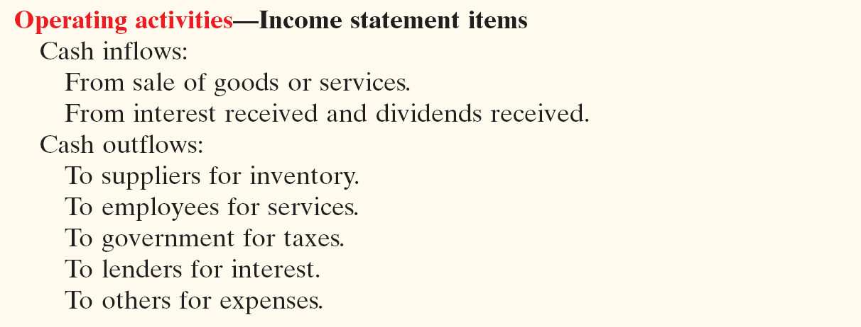
Classification of Cash Flows
Types of Cash Inflows and Outflows
Illustration 13-1
SO 2 Distinguish among operating, investing, and financing activities.

Slide 9
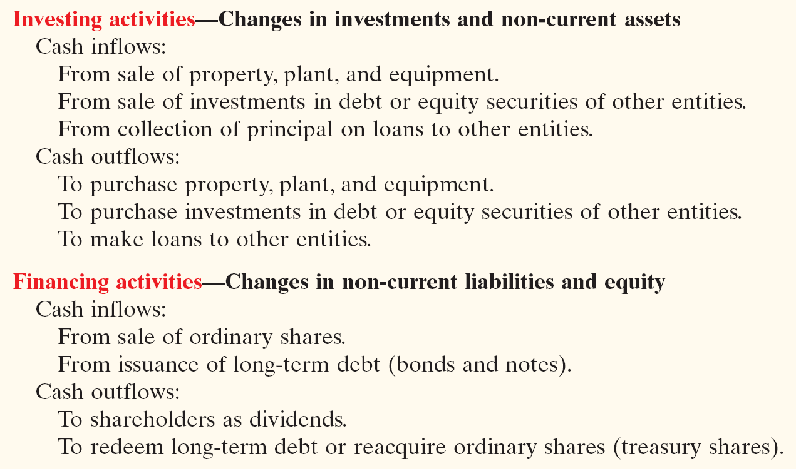
Classification of Cash Flows
Types of Cash Inflows and Outflows
Illustration 13-1
SO 2 Distinguish among operating, investing, and financing activities.

Slide 10
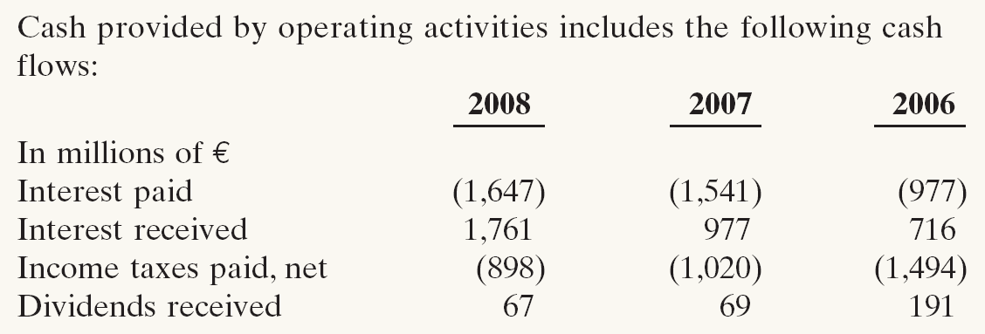
Classification of Cash Flows
Types of Cash Inflows and Outflows
IFRS requires that the following amounts be disclosed:
Cash paid for taxes.
Cash received and paid from interest and dividends.
Illustration 13-2
Daimler’s statement of cash flows note
SO 2 Distinguish among operating, investing, and financing activities.

Slide 11
Usefulness and Format
Significant Non-Cash Activities
Direct issuance of ordinary shares to purchase assets.
Conversion of bonds into ordinary shares.
Direct issuance of debt to purchase assets.
Exchanges of plant assets.
Companies report these activities in either a separate note or supplementary schedule to the financial statements.
SO 2 Distinguish among operating, investing, and financing activities.

Slide 12
Notes:
p. 603 Net What?
Q: In general, why do differences exist between net income and net cash provided by operating activities?
A: The differences are explained by differences in the timing of the reporting of revenues and expenses under accrual accounting versus cash. Under accrual accounting, companies report revenues when earned, even if cash hasn’t been received, and they report expenses when incurred, even if cash hasn’t been paid.

Slide 13
Usefulness and Format
Format of the Statement of Cash Flows
Order of Presentation:
Operating activities.
Investing activities.
Financing activities.
Direct Method
Indirect Method
The cash flows from operating activities section always appears first, followed by the investing and financing sections.
SO 2 Distinguish among operating, investing, and financing activities.

Slide 14
Format of the Statement of Cash Flows
Illustration 13-3
SO 2 Distinguish among operating, investing, and financing activities.

Slide 15
Format of the Statement of Cash Flows
During its first week, Hu Na Company had these transactions.
Classification
Issued 100,000 HK$50 par value ordinary shares for HK$8,000,000 cash.
Borrowed HK$2,000,000 from Castle Bank, signing a 5-year note bearing 8% interest.
Purchased two semi-trailer trucks for HK$1,700,000 cash.
Paid employees HK$120,000 for salaries and wages.
Collected HK$200,000 cash for services provided.
Financing
Financing
Investing
Operating
Operating
SO 2 Distinguish among operating, investing, and financing activities.

Slide 16
Usefulness and Format
Preparing the Statement of Cash Flows
Three Sources of Information:
Comparative statement of financial position
Current income statement
Additional information
SO 2 Distinguish among operating, investing, and financing activities.

Slide 17
Usefulness and Format
Three Major Steps:
Illustration 13-4
SO 2 Distinguish among operating, investing, and financing activities.

Slide 18
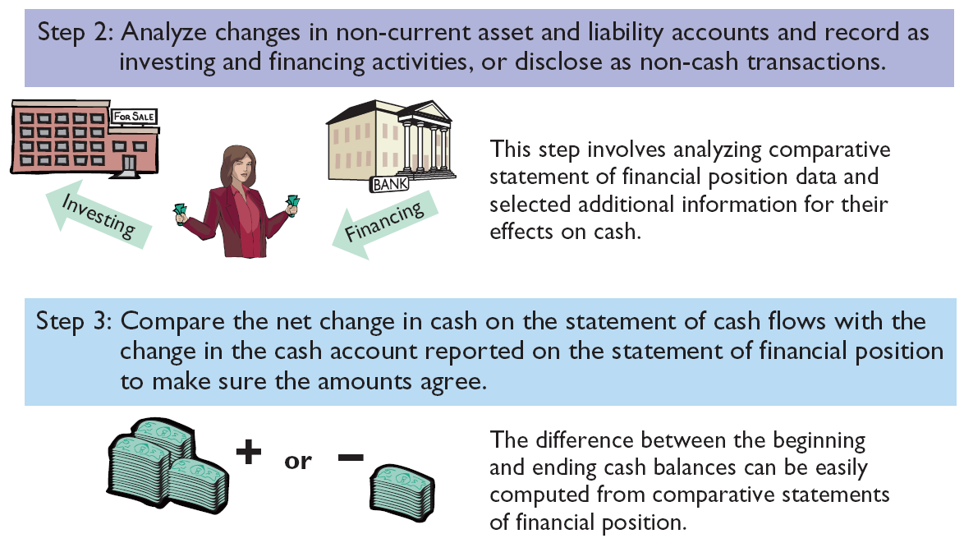
Usefulness and Format
Three Major Steps:
Illustration 13-4
SO 2 Distinguish among operating, investing, and financing activities.

Slide 19
Usefulness and Format
Indirect and Direct Methods
Companies favor the indirect method for two reasons:
Easier and less costly to prepare, and
Focuses on the differences between net income and net cash flow from operating activities.
SO 2 Distinguish among operating, investing, and financing activities.

Slide 20
Notes:
p. 605 Cash Flow Isn’t Always What It Seems
Q: For what reasons might managers at WorldCom and at Dynegy take the actions noted above?
A: Analysts increasingly use cash-flow-based measures of income, such as cash flow provided by operations, in addition to net income. More investors now focus on cash flow from operations, and some compensation contracts now have bonuses tied to cash-flow numbers. Thus, some managers have taken actions that artificially increase cash flow from operations.

Slide 21
Preparing the Statement of Cash Flows
Illustration
Illustration 13-5
Indirect Method
SO 3 Prepare a statement of cash flows using the indirect method.

Slide 22
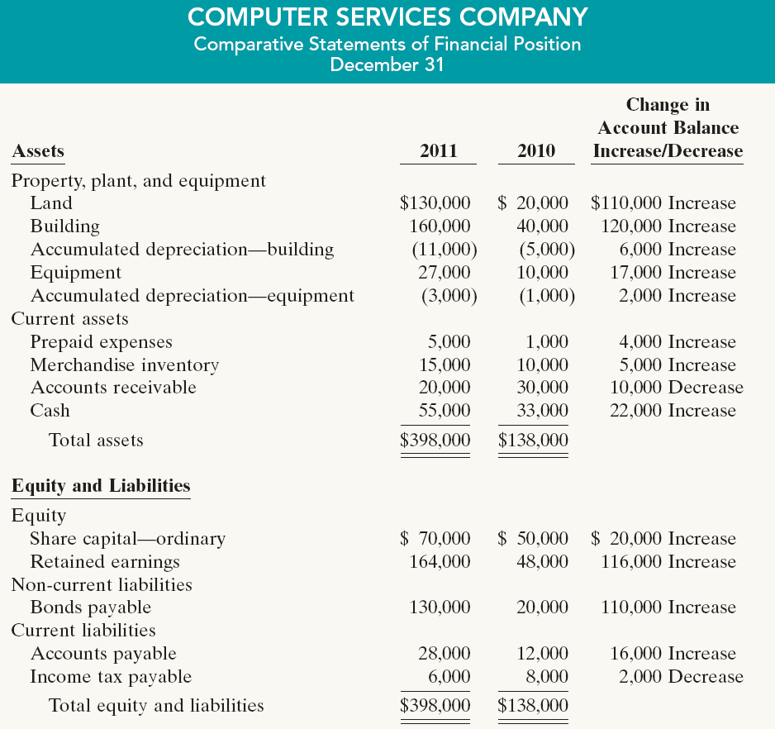
Preparing the Statement of Cash Flows
Indirect Method
Illustration 13-5
SO 3 Prepare a statement of cash flows using the indirect method.

