Slide 3
Chapter 11
Corporations: Organization, Share Transactions, Dividends, and Retained Earnings
Financial Accounting, IFRS Edition
Weygandt Kimmel Kieso

Slide 4
Study Objectives
Identify the major characteristics of a corporation.
Record the issuance of ordinary shares.
Explain the accounting for treasury shares.
Differentiate preference shares from ordinary shares.
Prepare the entries for cash dividends and share dividends.
Identify the items that are reported in a retained earnings statement.
Prepare and analyze a comprehensive equity section.

Slide 5
Corporations: Organization, Share Transactions, Dividends, and Retained Earnings
Corporate Organization and Share Transactions
Dividends
Retained Earnings
Statement Presentation and Analysis
Corporate form of organization
Ordinary share issues
Treasury shares
Preference shares
Cash dividends
Share dividends
Share splits
Retained earnings restrictions
Prior period adjustments
Retained earnings statement
Presentation
Analysis

Slide 6
The Corporate Form of Organization
An entity separate and distinct from its owners.
Classified by Purpose
Not-for-Profit
For Profit
Classified by Ownership
Publicly held
Privately held
Salvation Army (USA)
International Committee of the Red Cross (CHE)
Bill & Melinda Gates Foundation (USA)
Compass Group (GBR)
Hyundai Motors (KOR)
LUKOIL (RUS)
Google (USA)
Cargill Inc. (USA)

Slide 7
The Corporate Form of Organization
Characteristics that distinguish corporations from proprietorships and partnerships.
Separate Legal Existence
Limited Liability of Shareholders
Transferable Ownership Rights
Ability to Acquire Capital
Continuous Life
Corporate Management
Government Regulations
Additional Taxes
Advantages
Disadvantages
SO 1 Identify the major characteristics of a corporation.

Slide 8
Characteristics of a Corporation
Characteristics that distinguish corporations from proprietorships and partnerships.
Corporation acts under its own name rather than in the name of its shareholders.
Separate Legal Existence
Limited Liability of Shareholders
Transferable Ownership Rights
Ability to Acquire Capital
Continuous Life
Corporate Management
Government Regulations
Additional Taxes
SO 1 Identify the major characteristics of a corporation.

Slide 9
Characteristics of a Corporation
Characteristics that distinguish corporations from proprietorships and partnerships.
Separate Legal Existence
Limited Liability of Shareholders
Transferable Ownership Rights
Ability to Acquire Capital
Continuous Life
Corporate Management
Government Regulations
Additional Taxes
Limited to their investment.
SO 1 Identify the major characteristics of a corporation.

Slide 10
Characteristics of a Corporation
Characteristics that distinguish corporations from proprietorships and partnerships.
Separate Legal Existence
Limited Liability of Shareholders
Transferable Ownership Rights
Ability to Acquire Capital
Continuous Life
Corporate Management
Government Regulations
Additional Taxes
Shareholders may sell their share.
SO 1 Identify the major characteristics of a corporation.

Slide 11
Characteristics of a Corporation
Characteristics that distinguish corporations from proprietorships and partnerships.
Separate Legal Existence
Limited Liability of Shareholders
Transferable Ownership Rights
Ability to Acquire Capital
Continuous Life
Corporate Management
Government Regulations
Additional Taxes
Corporation can obtain capital through the issuance of shares.
SO 1 Identify the major characteristics of a corporation.

Slide 12
Characteristics of a Corporation
Characteristics that distinguish corporations from proprietorships and partnerships.
Separate Legal Existence
Limited Liability of Shareholders
Transferable Ownership Rights
Ability to Acquire Capital
Continuous Life
Corporate Management
Government Regulations
Additional Taxes
Continuance as a going concern is not affected by the withdrawal, death, or incapacity of a shareholder, employee, or officer.
SO 1 Identify the major characteristics of a corporation.

Slide 13
Characteristics of a Corporation
Characteristics that distinguish corporations from proprietorships and partnerships.
Separate Legal Existence
Limited Liability of Shareholders
Transferable Ownership Rights
Ability to Acquire Capital
Continuous Life
Corporate Management
Government Regulations
Additional Taxes
Separation of ownership and management prevents owners from having an active role in managing the company.
SO 1 Identify the major characteristics of a corporation.

Slide 14
Characteristics of a Corporation
Characteristics that distinguish corporations from proprietorships and partnerships.
Separate Legal Existence
Limited Liability of Shareholders
Transferable Ownership Rights
Ability to Acquire Capital
Continuous Life
Corporate Management
Government Regulations
Additional Taxes
Government regulations are designed to protect the owners of the corporation.
SO 1 Identify the major characteristics of a corporation.

Slide 15
Characteristics of a Corporation
Characteristics that distinguish corporations from proprietorships and partnerships.
Separate Legal Existence
Limited Liability of Shareholders
Transferable Ownership Rights
Ability to Acquire Capital
Continuous Life
Corporate Management
Government Regulations
Additional Taxes
Corporations pay income taxes as a separate legal entity and in addition, shareholders pay taxes on cash dividends.
SO 1 Identify the major characteristics of a corporation.

Slide 16
Characteristics of a Corporation
Shareholders
Illustration 11-1 Corporation organization chart
Chairman and
Board of
Directors
President and
Chief Executive
Officer
General
Counsel and
Secretary
Vice President
Marketing
Vice President
Finance/Chief
Financial Officer
Vice President
Operations
Vice President
Human
Resources
Treasurer
Controller
SO 1 Identify the major characteristics of a corporation.

Slide 17
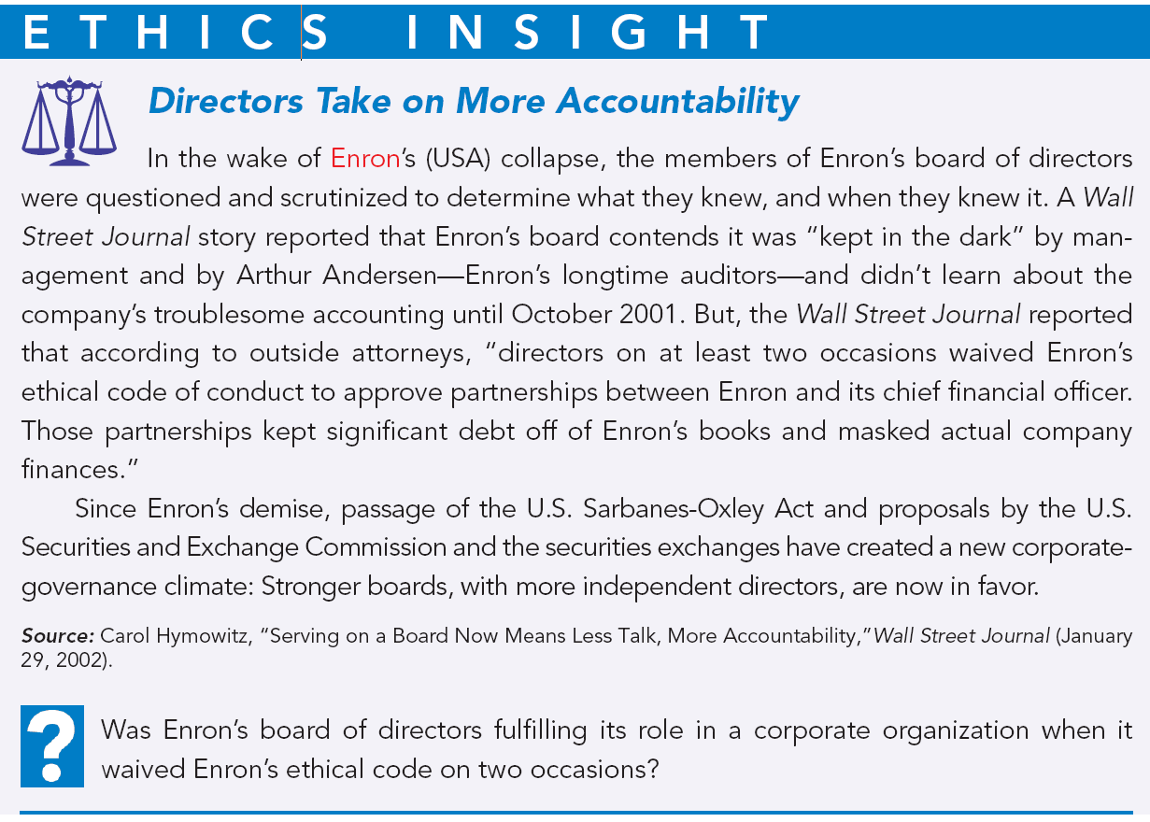
Answer on notes page
Notes:
p. 499 Directors Take on More Accountability
Q: Was Enron’s board of directors fulfilling its role in a corporate organization when it waived Enron’s ethical code on two occasions?
A: The board of directors is elected by the owners (shareholders) of the corporation to manage the corporation. One of its roles is to formulate the ethical and operating policies for the company and to assume an oversight responsibility on behalf of the shareholders and other third parties. It was the responsibility of the board of directors to enforce the corporation’s ethical code, not to waive it.

Slide 18
Forming a Corporation
Initial Steps:
File application with governmental agency in the jurisdiction in which incorporation is desired.
Government grants charter.
Corporation develops by-laws.
Companies incorporate in a state or country whose laws are favorable to the corporate form of business.
Corporations expense organization costs as incurred.
SO 1 Identify the major characteristics of a corporation.

Slide 19
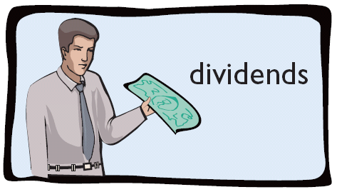
Ownership Rights of Shareholders
Shareholders have the right to:
Illustration 11-3
1. Vote in election of board of directors and on actions that require shareholder approval.
2. Share the corporate earnings through receipt of dividends.
SO 1 Identify the major characteristics of a corporation.

Slide 20
Ownership Rights of Shareholders
Shareholders have the right to:
Illustration 11-3
3. Keep the same percentage ownership when new shares of share are issued (preemptive right*).
* A number of companies have eliminated the preemptive right.
SO 1 Identify the major characteristics of a corporation.

Slide 21
Ownership Rights of Shareholders
Shareholders have the right to:
Illustration 11-3
4. Share in assets upon liquidation in proportion to their holdings. This is called a residual claim.
SO 1 Identify the major characteristics of a corporation.

Slide 22
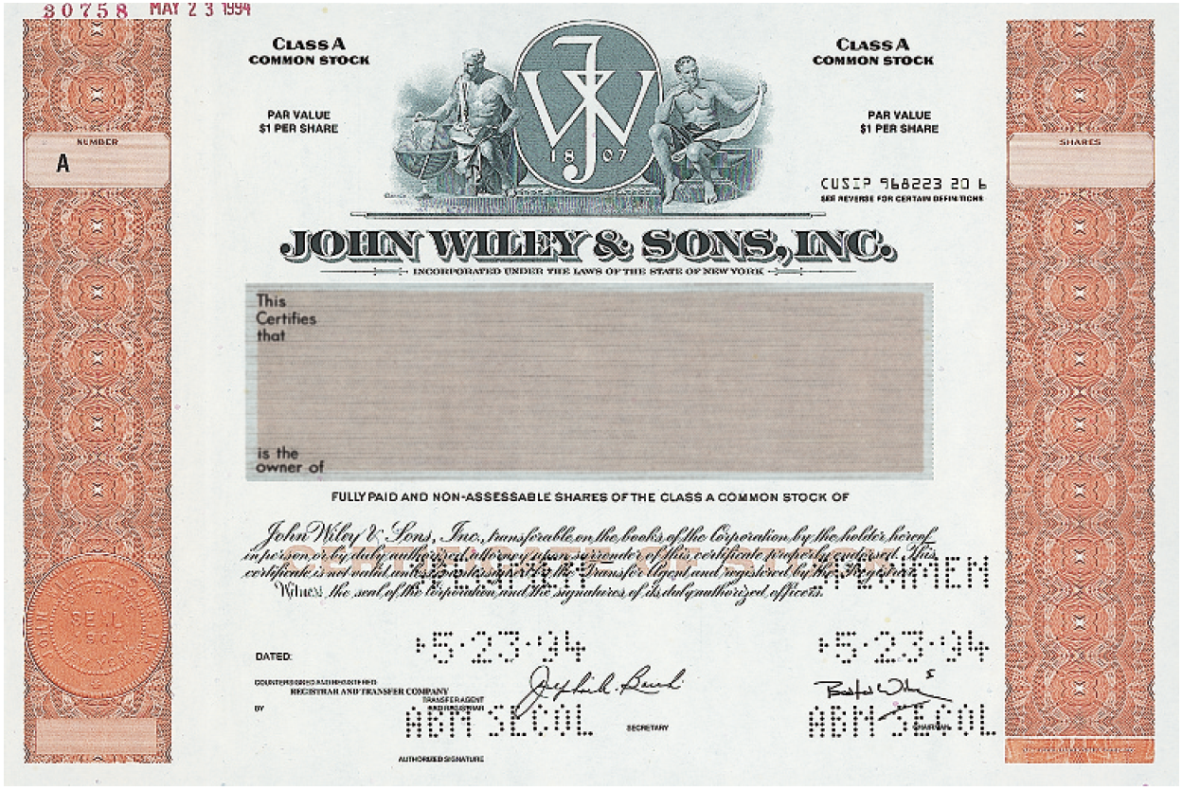
Ownership Rights of Shareholders
Illustration 11-4
Prenumbered
Class
Class A COMMON STOCK
Class A COMMON STOCK
PAR VALUE $1 PER SHARE
PAR VALUE $1 PER SHARE
Name of corporation
shareholder’s name
Shares
Share Certificate
Signature of corporate official
SO 1 Identify the major characteristics of a corporation.

Slide 23
Share Issue Considerations
Authorized Shares
Charter indicates the amount of shares that a corporation is authorized to sell.
Number of authorized shares is often reported in the equity section.
SO 1 Identify the major characteristics of a corporation.

Slide 24
Share Issue Considerations
Issuance of Shares
Corporation can issue shares directly to investors or indirectly through an investment banking firm.
Factors in setting price for a new issue of shares:
the company’s anticipated future earnings
its expected dividend rate per share
its current financial position
the current state of the economy
the current state of the securities market
SO 1 Identify the major characteristics of a corporation.

Slide 25
Share Issue Considerations
Market Value of Shares
Shares of publicly held companies are traded on organized exchanges.
Interaction between buyers and sellers determines the prices per share.
Prices set by the marketplace tend to follow the trend of a company’s earnings and dividends.
Factors beyond a company’s control may cause day-to-day fluctuations in market prices.
SO 1 Identify the major characteristics of a corporation.

Slide 26
SO 1 Identify the major characteristics of a corporation.

Slide 27
Share Issue Considerations
Par and No-Par Value Shares
Years ago, par value determined the legal capital per share that a company must retain in the business for the protection of corporate creditors.
Today many governments do not require a par value.
No-par value shares are quite common today.
In many countries the board of directors assigns a stated value to no-par shares.
SO 1 Identify the major characteristics of a corporation.

Slide 28
Corporate Capital
Illustration 11-5
SO 1 Identify the major characteristics of a corporation.

Slide 29
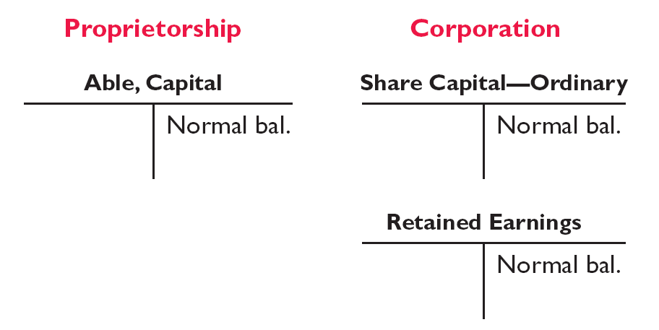
Corporate Capital
Comparison of the equity accounts for a proprietorship and a corporation.
Illustration 11-6
SO 1 Identify the major characteristics of a corporation.

Slide 30
Corporate Capital
At the end of its first year of operation, Doral Corporation has C750,000 of ordinary share and
=
net income of C122,000. Prepare (a) the closing entry for net income and (b) the equity section at year-end.
=
Answer on notes page
SO 1 Identify the major characteristics of a corporation.

