Slide 1
WILEY
IFRS EDITION
Prepared by
Coby Harmon
University of California, Santa Barbara
Westmont College

Slide 2
PREVIEW OF CHAPTER 3
Financial Accounting
IFRS 3rd Edition
Weygandt ● Kimmel ● Kieso

Slide 3
CHAPTER
3
Adjusting the Accounts
LEARNING OBJECTIVES
After studying this chapter, you should be able to:
Explain the time period assumption.
Explain the accrual basis of accounting.
Explain the reasons for adjusting entries.
Identify the major types of adjusting entries.
Prepare adjusting entries for deferrals.
Prepare adjusting entries for accruals.
Describe the nature and purpose of an adjusted trial balance.

Slide 4
Types of Adjusting Entries
Learning Objective 4 Identify the major types of adjusting entries.
Deferrals
Accruals
1. Prepaid Expenses. Expenses paid in cash before they are used or consumed.
1. Accrued Revenues. Revenues for services performed but not yet received in cash or recorded.
2. Unearned Revenues.
Cash received before services are performed.
2. Accrued Expenses. Expenses incurred but not yet paid in cash or recorded.
Illustration 3-2
Categories of adjusting entries
LO 4

Slide 5
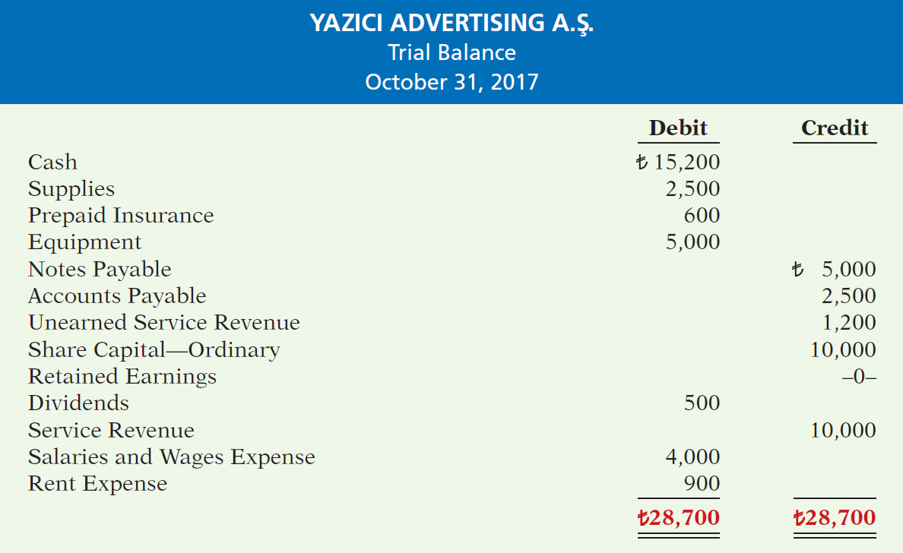
Illustration 3-3
Trial balance
Each account is analyzed to determine whether it is complete and up-to-date for financial statement purposes.
LO 4

Slide 6
Adjusting Entries for Deferrals
Learning Objective 5 Prepare adjusting entries for deferrals.
Deferrals are expenses or revenues that are recognized at a date later than the point when cash was originally exchanged. There are two types:
Prepaid expenses and
Unearned revenues.
LO 5

Slide 7
PREPAID EXPENSES
Payments of expenses that will benefit more than one accounting period.
Cash Payment
BEFORE
Expense Recorded
Prepayments often occur in regard to:
insurance
supplies
advertising
rent
buildings and equipment
LO 5

Slide 8
PREPAID EXPENSES
Expire either with the passage of time or through use.
Adjusting entry:
Increase (debit) to an expense account and
Decrease (credit) to an asset account.
Illustration 3-4
Adjusting entries for prepaid
expenses
LO 5

Slide 9
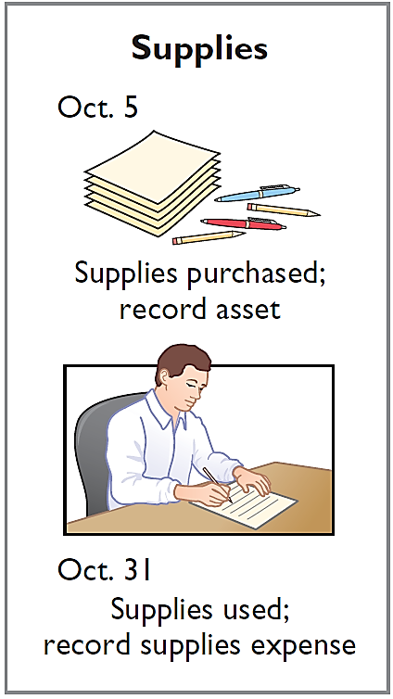
PREPAID EXPENSES
Illustration: Yazici Advertising Inc. Inc. purchased supplies costing ₺2,500 on October 5. Yazici recorded the purchase by increasing (debiting) the asset Supplies. This account shows a balance of ₺2,500 in the October 31 trial balance. An inventory count at the close of business on October 31 reveals that ₺1,000 of supplies are still on hand.
Oct. 31
Supplies Expense
1,500
Supplies
1,500
LO 5

Slide 10
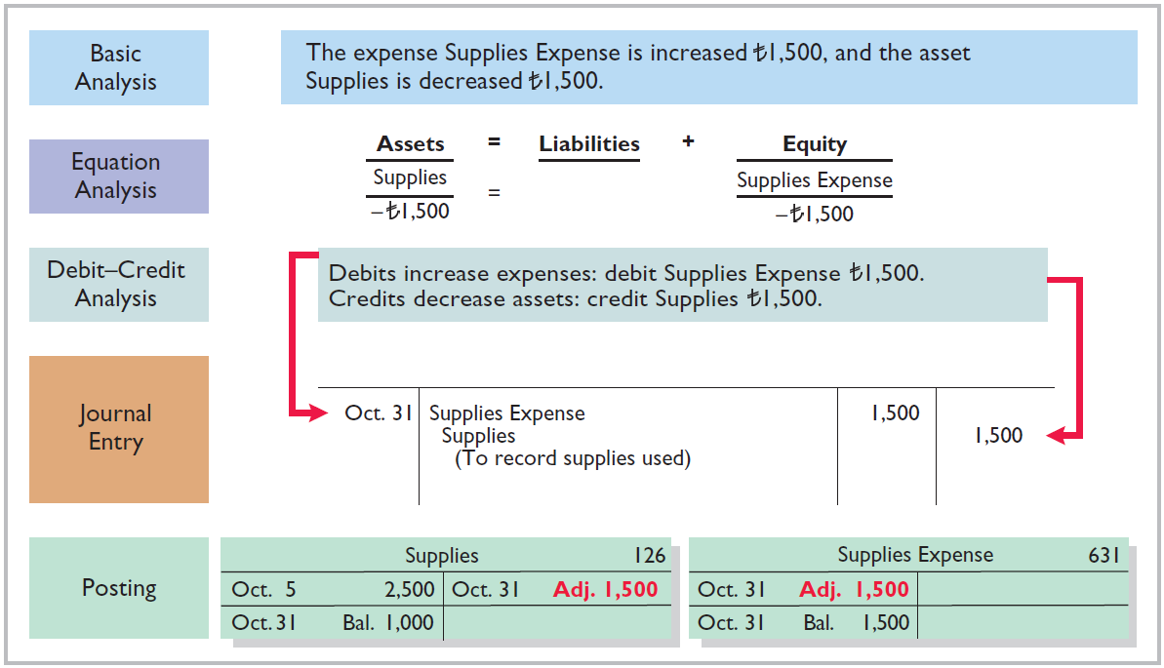
Illustration 3-5
Adjustment for supplies
LO 5

Slide 11
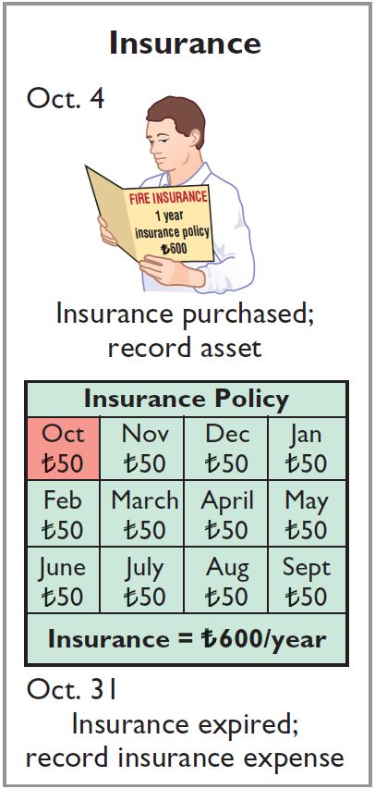
PREPAID EXPENSES
Illustration: On October 4, Yazici Advertising Inc. paid ₺600 for a one-year fire insurance policy. Coverage began on October 1. Yazici recorded the payment by increasing (debiting) Prepaid Insurance. This account shows a balance of ₺600 in the October 31 trial balance. Insurance of ₺50 (₺600 ÷ 12) expires each month.
Oct. 31
Insurance Expense
50
Prepaid Insurance
50
LO 5

Slide 12
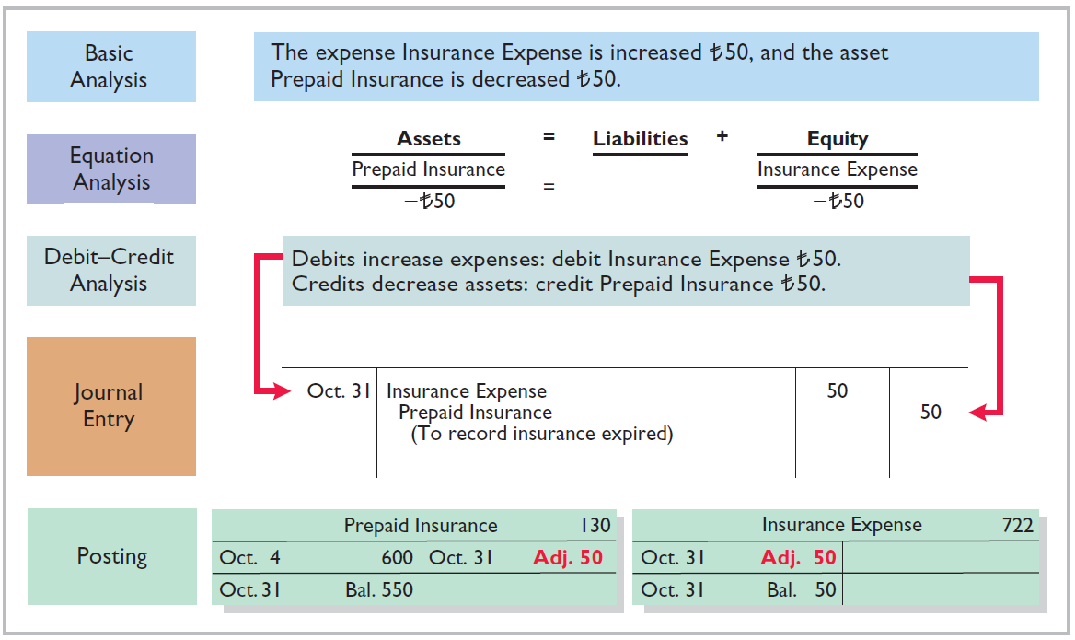
Illustration 3-6
Adjustment for insurance
LO 5

Slide 13
PREPAID EXPENSES
DEPRECIATION
Buildings, equipment, and motor vehicles (assets that provide service for many years) are recorded as assets, rather than an expense, on the date acquired.
Depreciation is the process of allocating the cost of an asset to expense over its useful life.
Depreciation does not attempt to report the actual change in the value of the asset.
LO 5

Slide 14
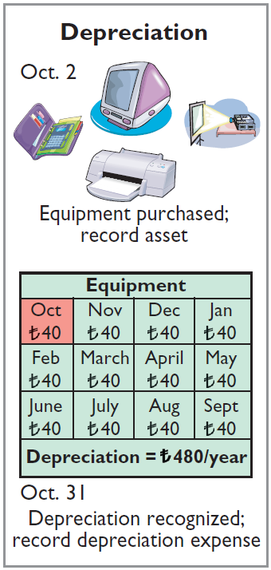
PREPAID EXPENSES
Illustration: For Yazici Advertising, assume that depreciation on the equipment is ₺480 a year, or ₺40 per month.
Oct. 31
Depreciation Expense
40
Accumulated Depreciation
40
Accumulated Depreciation is called a contra asset account.
HELPFUL HINT
All contra accounts have increases, decreases, and normal balances opposite to the account to which they relate.
LO 5

Slide 15
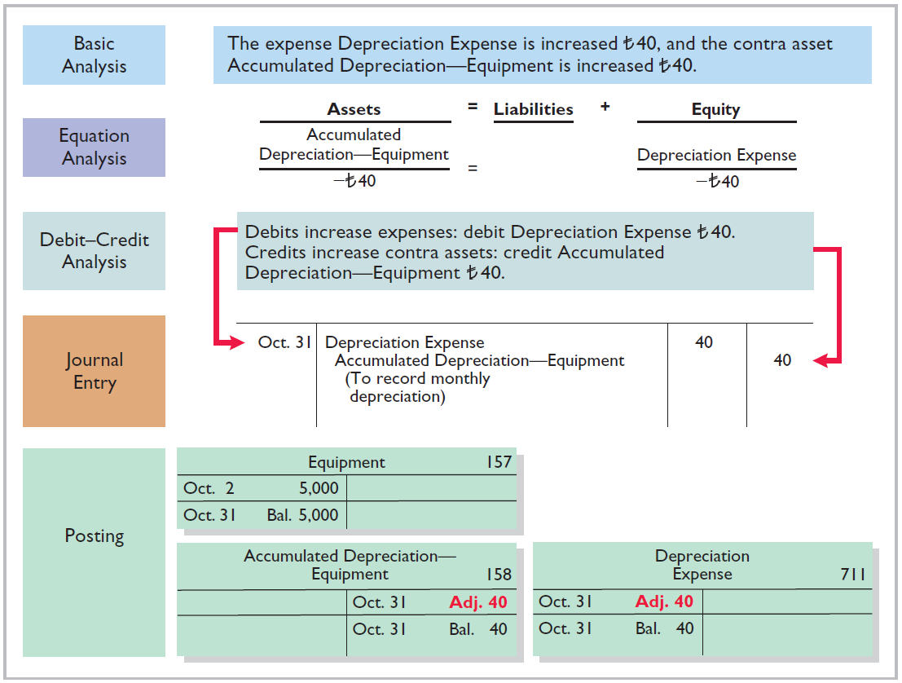
Illustration 3-7
Adjustment for depreciation
LO 5

Slide 16
PREPAID EXPENSES
Statement Presentation
Accumulated Depreciation is a contra asset account (credit).
Appears just after the account it offsets (Equipment) on the balance sheet.
Book value is the difference between the cost of any depreciable asset and its accumulated depreciation.
Illustration 3-8
Statement of financial position presentation of accumulated depreciation
LO 5

Slide 17
PREPAID EXPENSES
Illustration 3-9
Accounting for prepaid expenses
LO 5

Slide 18
UNEARNED REVENUES
Receipt of cash that is recorded as a liability because the service has not been performed.
Cash Receipt
BEFORE
Revenue Recorded
Unearned revenues often occur in regard to:
Rent
Airline tickets
Magazine subscriptions
Customer deposits
LO 5

Slide 19
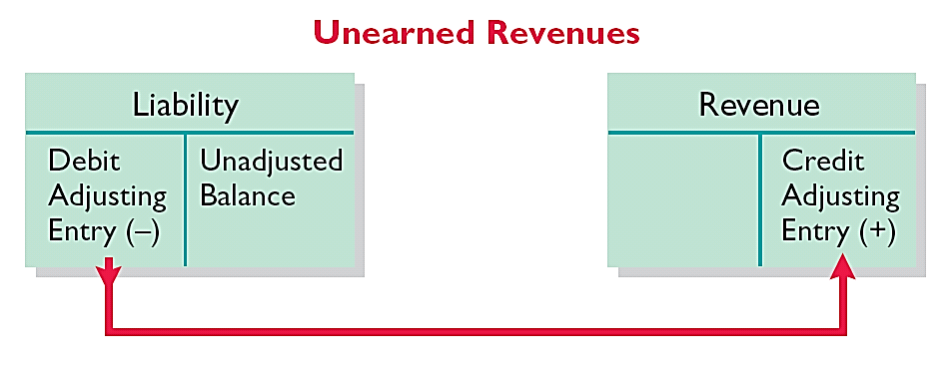
UNEARNED REVENUES
Adjusting entry is made to record the revenue for services performed during the period and to show the liability that remains at the end of the accounting period.
Results in a decrease (debit) to a liability account and an increase (credit) to a revenue account.
Illustration 3-10
Adjusting entries for unearned
revenues
LO 5

Slide 20
UNEARNED REVENUES
Illustration: Yazici Advertising Inc. received ₺1,200 on October 2 from R. Knox for advertising services expected to be completed by December 31. Unearned Service Revenue shows a balance of ₺1,200 in the October 31 trial balance. Analysis reveals that the company performed ₺400 of services in October.
Oct. 31
Unearned Service Revenue
400
Service Revenue
400
LO 5

Slide 21
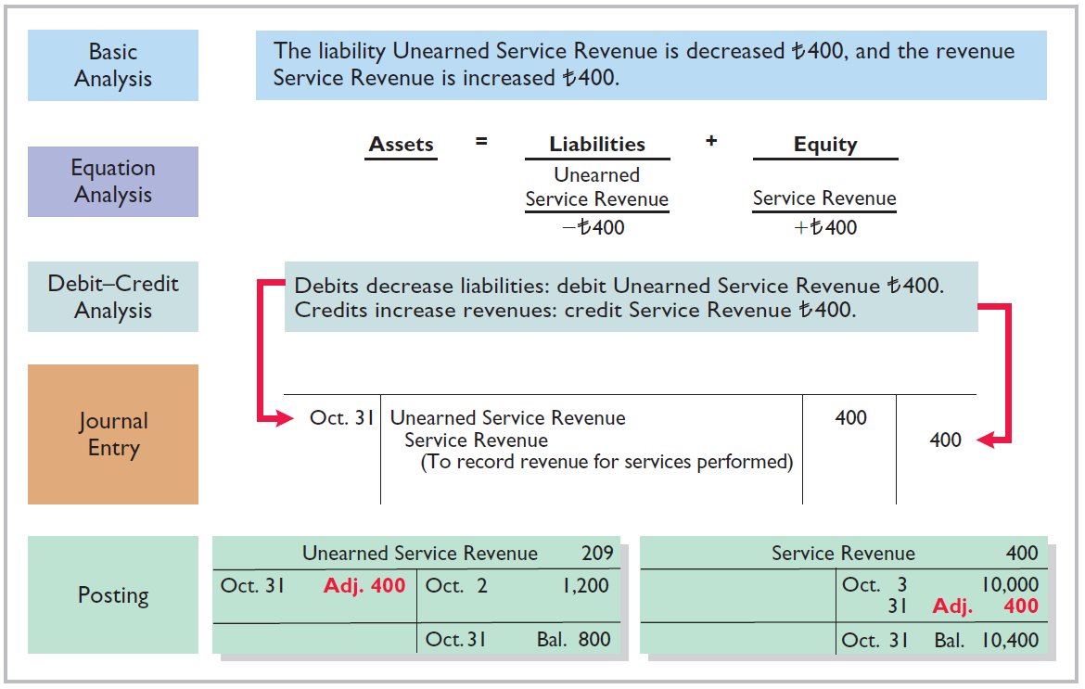
Illustration 3-11
Service revenue accounts after adjustment
LO 5

Slide 22
UNEARNED REVENUES
Illustration 3-12
Accounting for unearned revenues
LO 5

Slide 23
ACCOUNTING ACROSS THE ORGANIZATION
Turning Gift Cards into Revenue
Those of you who are marketing majors (and even most of you who are not) know that gift cards are among the hottest marketing tools in merchandising today. Customers at stores such as Marks & Spencer plc (GBR) purchase gift cards and give them to someone for later use. Although these programs are popular with marketing executives, they create accounting questions. Should revenue be recorded at the time the gift card is sold, or when it is exercised? How should expired gift cards be accounted for?
Source: Robert Berner, “Gift Cards: No Gift to Investors,” BusinessWeek (March 14, 2005), p. 86.
LO 5

Slide 24
>
DO IT!
The ledger of Zhu Company on March 31, 2017, includes these selected accounts before adjusting entries are prepared.
(amounts in thousands) Debit Credit
Prepaid Insurance ¥ 3,600
Supplies 2,800
Equipment 25,000
Accumulated Depreciation—Equipment ¥ 5,000
Unearned Service Revenue 9,200
An analysis of the accounts shows the following.
Insurance expires at the rate of ¥100 per month.
Supplies on hand total ¥800.
The equipment depreciates ¥200 a month.
One-half of the unearned service revenue was performed in March.
Prepare the adjusting entries for the month of March.
LO 5

Slide 25
>
DO IT!
The ledger of Zhu Company on March 31, 2017, includes these selected accounts before adjusting entries are prepared.
(amounts in thousands) Debit Credit
Prepaid Insurance ¥ 3,600
Supplies 2,800
Equipment 25,000
Accumulated Depreciation—Equipment ¥ 5,000
Unearned Service Revenue 9,200
Prepare the adjusting entries for the month of March.
Insurance expires at the rate of ¥100 per month.
Insurance Expense 100
Prepaid Insurance 100
LO 5

Slide 26
>
DO IT!
The ledger of Zhu Company on March 31, 2017, includes these selected accounts before adjusting entries are prepared.
(amounts in thousands) Debit Credit
Prepaid Insurance ¥ 3,600
Supplies 2,800
Equipment 25,000
Accumulated Depreciation—Equipment ¥ 5,000
Unearned Service Revenue 9,200
Prepare the adjusting entries for the month of March.
Supplies on hand total ¥800.
Supplies Expense 2,000
Supplies 2,000
LO 5

Slide 27
>
DO IT!
The ledger of Zhu Company on March 31, 2017, includes these selected accounts before adjusting entries are prepared.
(amounts in thousands) Debit Credit
Prepaid Insurance ¥ 3,600
Supplies 2,800
Equipment 25,000
Accumulated Depreciation—Equipment ¥ 5,000
Unearned Service Revenue 9,200
Prepare the adjusting entries for the month of March.
The equipment depreciates ¥200 a month.
Depreciation Expense 200
Accumulated Depreciation—Equipment 200
LO 5

Slide 28
>
DO IT!
The ledger of Zhu Company on March 31, 2017, includes these selected accounts before adjusting entries are prepared.
(amounts in thousands) Debit Credit
Prepaid Insurance ¥ 3,600
Supplies 2,800
Equipment 25,000
Accumulated Depreciation—Equipment ¥ 5,000
Unearned Service Revenue 9,200
Prepare the adjusting entries for the month of March.
One-half of the unearned service revenue was performed in March.
Unearned Service Revenue 4,600
Service Revenue 4,600
LO 5

